Slide 1
Shapes Editor/Paint using OOPs
Group Members:
Abhishek Dharmadhikari(111903007)
Abhay Gaikwad(111903003)
Abhishek Gaikwad(111903006)

Slide 2
Objectives:
Draw various drawings ,saving them in formats like JPG, PDF, BMP
The drawing will have tools like rectangle, square, circle, ellipse, triangle, polygons of any shape .
Defining certain operations of coloring the borders , areas, erasing elements, changing size and shape, moving elements around.
Drawing Graph for data provided.

Slide 3
Project structure and functionalities:
Creating class of Polygon, lines , point as individual base classes
A component inherits a basic class, which has such the properties as position, size, color as well as methods to display it on the screen, hide, move, resize.
Class will handle events form mouse and keyboard.(Event handling)
Event handlers of mouse and keyboard calling the appropriate methods of the class.
Eg . Scale() used to repaint an object if a user change it size. Geometrical classes will have specific methods like Move(); Rotate(); and others.

Slide 4
Action Plan:
Writing code for base class of polygon, line, point and derived classes like rectangle , circle, ellipse.
1
Implementing different methods for shapes and ability to change properties of shapes using GUI( OpenGl library, MFC)
2
Writing code for event handling such as classes will handle events from mouse and keyboard using methods defined for class.
3

Slide 5
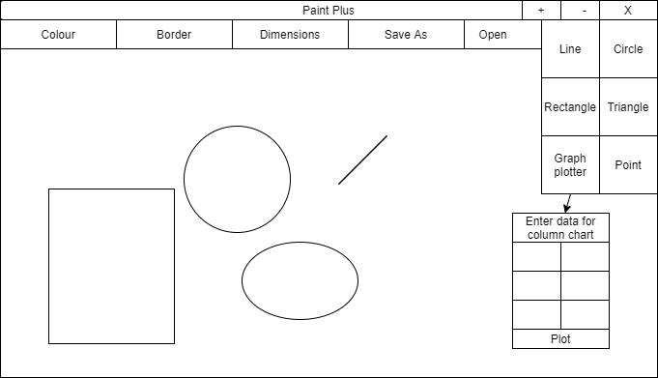

Slide 6
Thank you

